Slide 1
Smart Eye
limited
options
17million +
visual impaired
IoT
AI

Slide 2

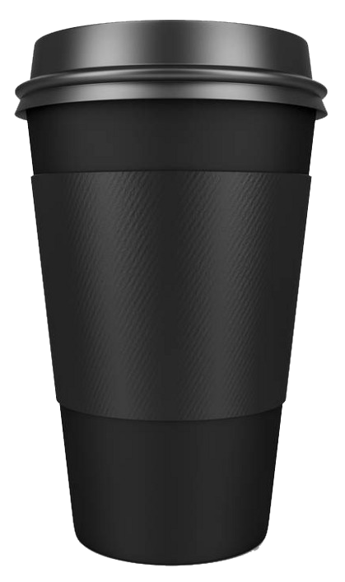


Google Assistant
3D Sound
Image Recognition

Slide 3
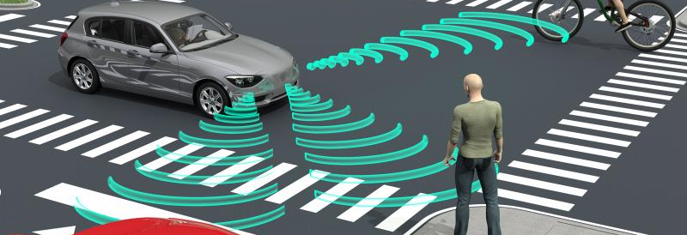
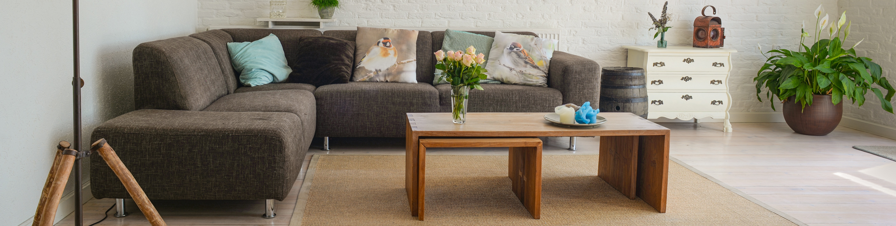
DEMO

